Slide 1
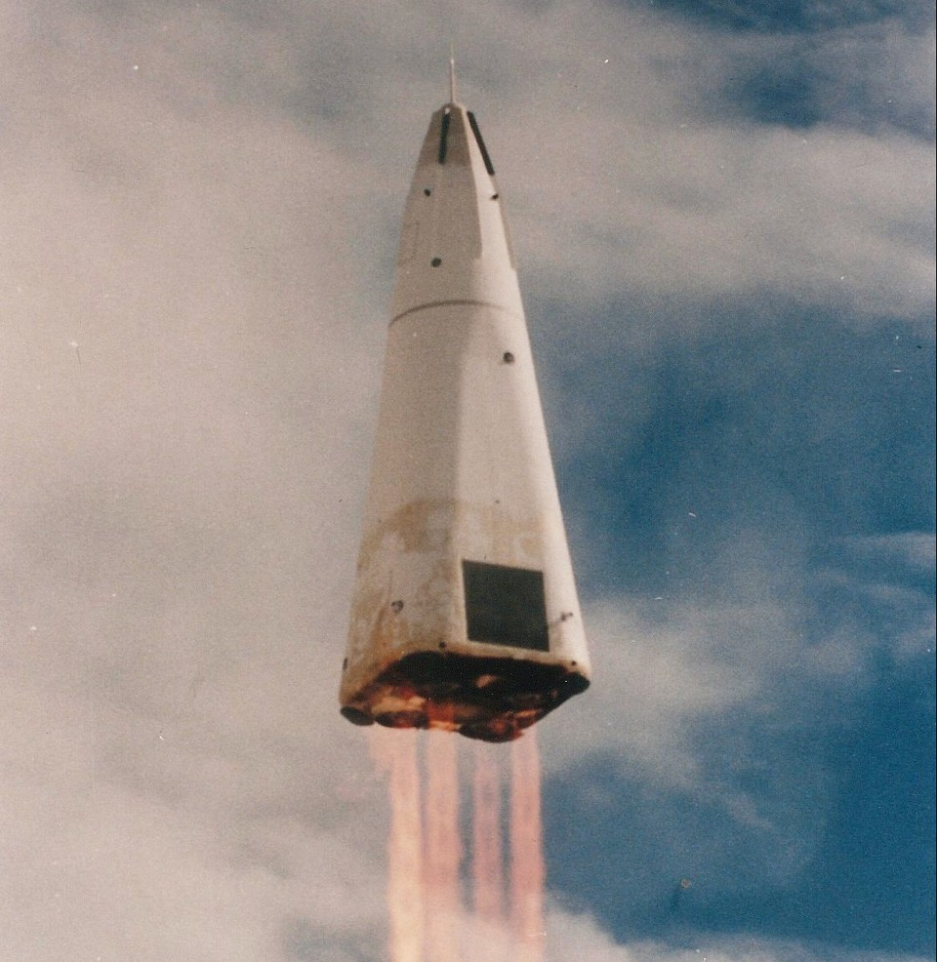
SPACE-Y REUSABLE ROCKET PROGRAM
Cost Optimization by Prediction Analysis

Slide 2


OUTLINE
Executive Summary
Introduction
Methodology
Results
Codes
Visualization – Charts
Dashboard
Conclusion

Slide 3
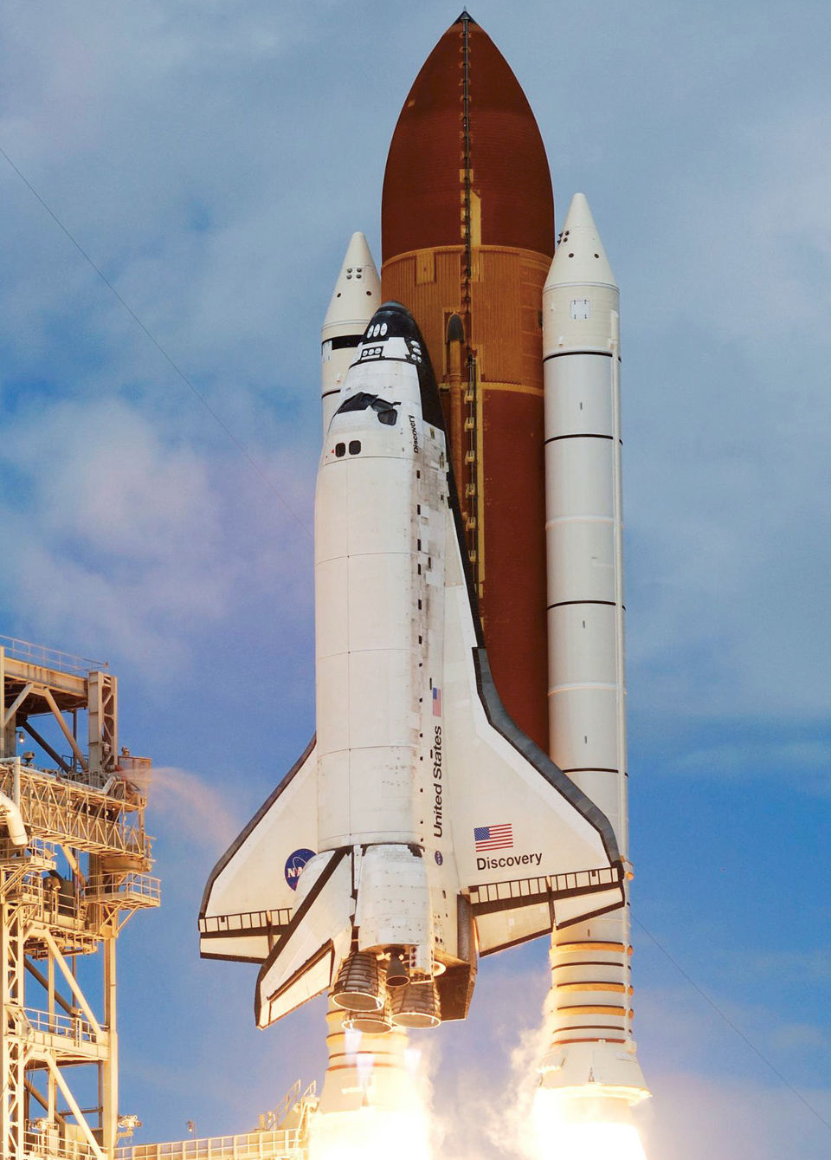

EXECUTIVE SUMMARY
In this capstone, The aim is to predict if the Falcon 9 first stage will land successfully with other relevant information
The Methodology involves Data Collection, Wrangling, EDA, Intractive Visual Analytics and Machine learning.
The following were key findings:
ES-L1, GEO, HEO and SSO are ideal orbit candidates with 100% success rate.
Successful launches generally improve over time.
Generally, there is an estimated 80% chances of successfully recovering the first stage across all launch sites.

Slide 4
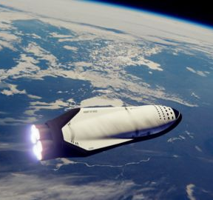
INTRODUCTION
The commercial space age is here, companies are making space travel affordable for everyone. Space X is successful because their rocket launches are relatively inexpensive
Space X launches cost $65m compared to the industry standard of $165m
Space Y wants to compete with Space X, cost competition can be achieved by predicting if the first stage will land
In this presentation, we seek to achieve this by
Apply knowledge of data science and machine learning in this scenario.
Analyze and visualize mined data using Python.
Build and validate a predictive machine learning model using Python.
Create and share actionable insights found.

Slide 5

METHODOLOGY (Data Collection and Wrangling)
Create a Jupyter notebook and make it sharable using GitHub.
Use an API to extract information from a web service.
Write Python code to manipulate data in a Pandas data frame.
Convert a JSON file into a Pandas data frame.
Load a dataset into a database.

Slide 6
METHODOLOGY (EDA and Interactive Visual Analytics)
Write and execute SQL queries to select and sort data.
Write Python code to conduct exploratory data analysis by manipulating data in a Pandas data frame.
Visualize the data and extract meaningful patterns to guide the modeling process.
Create scatter plots and bar charts to analyze data in a Pandas data frame.
Build an interactive map to analyze the launch site proximity with Folium.
Calculate distances on an interactive map by writing Python code using the Folium library.
Build an interactive dashboard that contains pie charts and scatter plots to analyze data with the Plotly Dash Python library.

Slide 7
METHODOLOGY (Predictive Analysis)
Train different classification models.
Split the data into training testing data.
Perform grid search to find the hyperparameters that allow a given algorithm to perform best.
Use machine learning skills to build a predictive model.

Slide 8
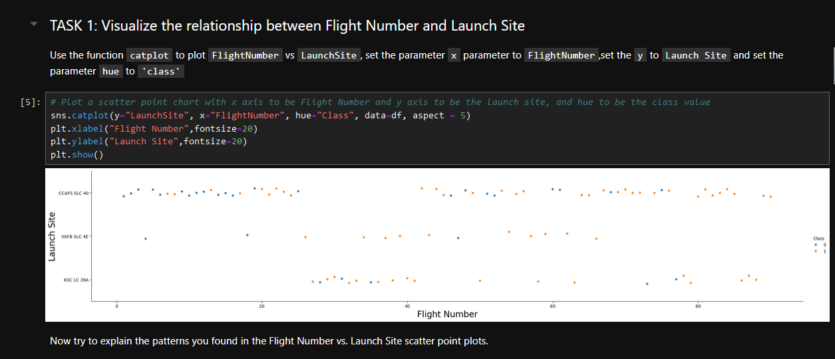
RESULTS (EDA with Visualization)

Slide 9
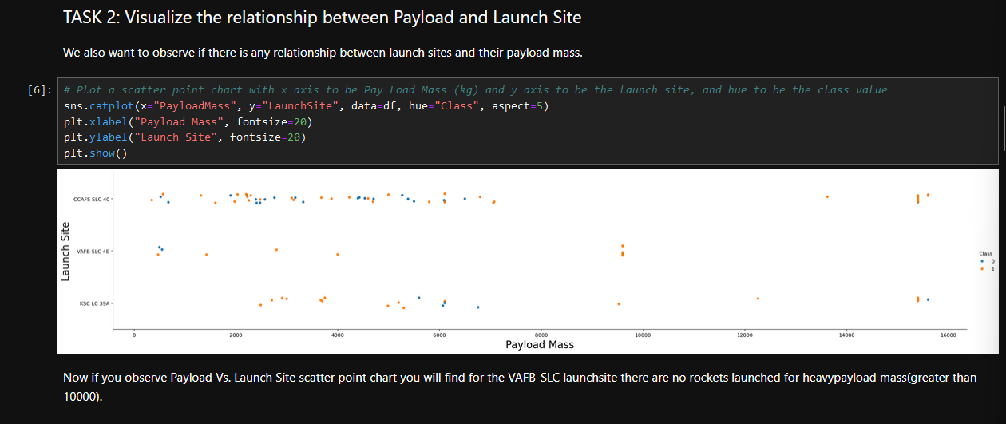
RESULTS (EDA with Visualization)

Slide 10
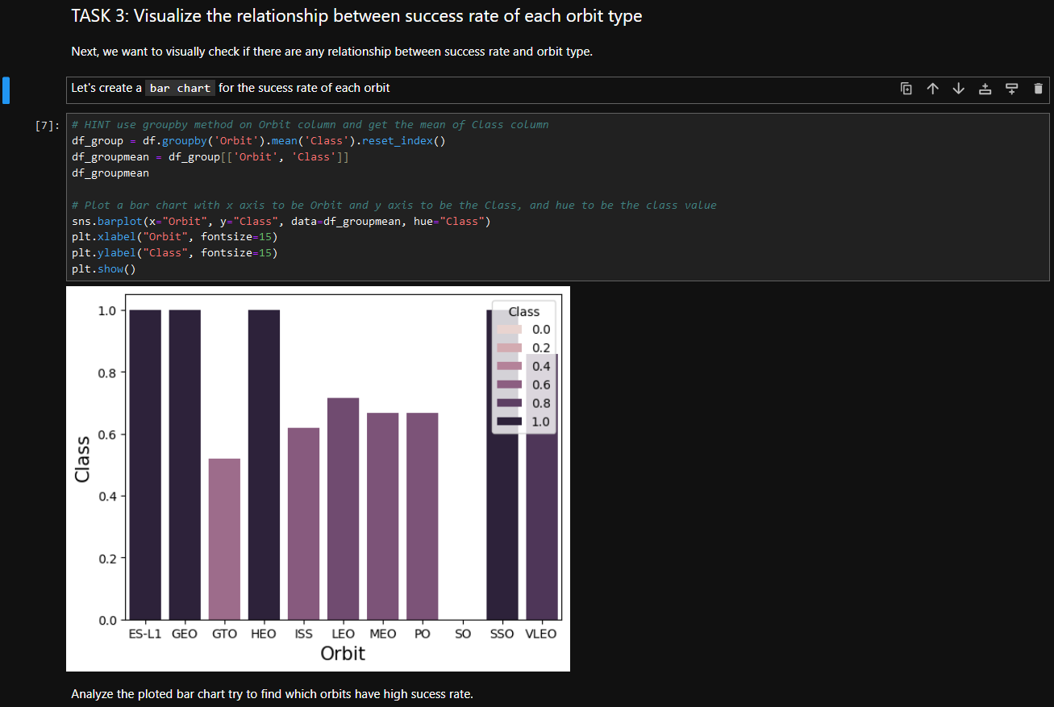
RESULTS (EDA with Visualization)

Slide 11
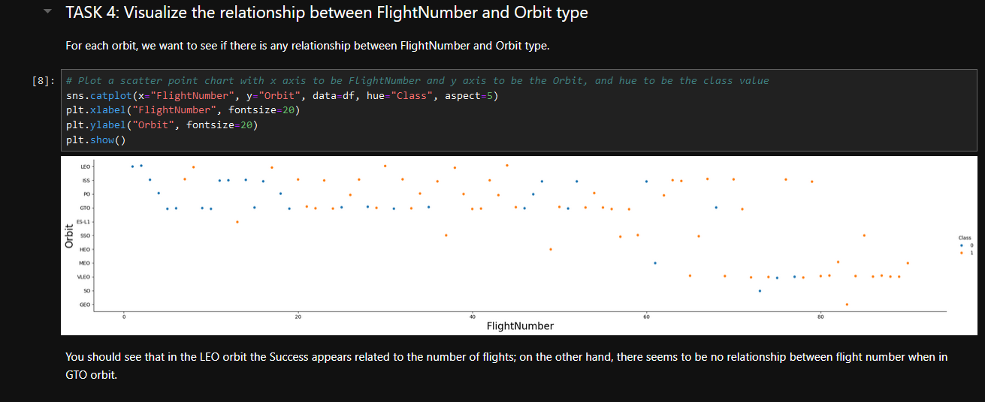
RESULTS (EDA with Visualization)

Slide 12
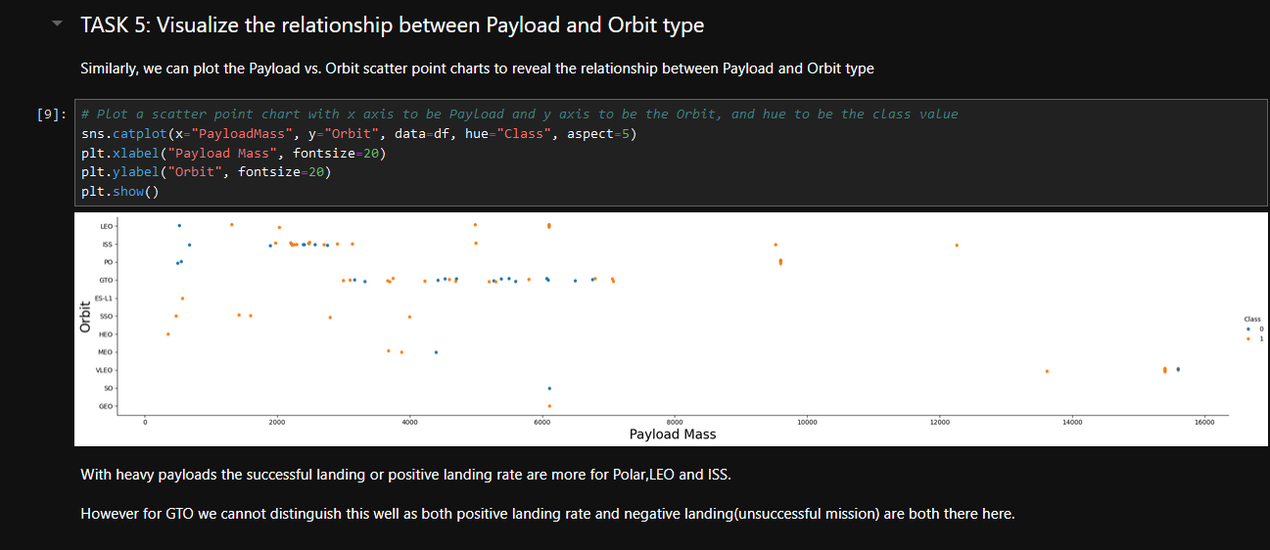
RESULTS (EDA with Visualization)

Slide 13
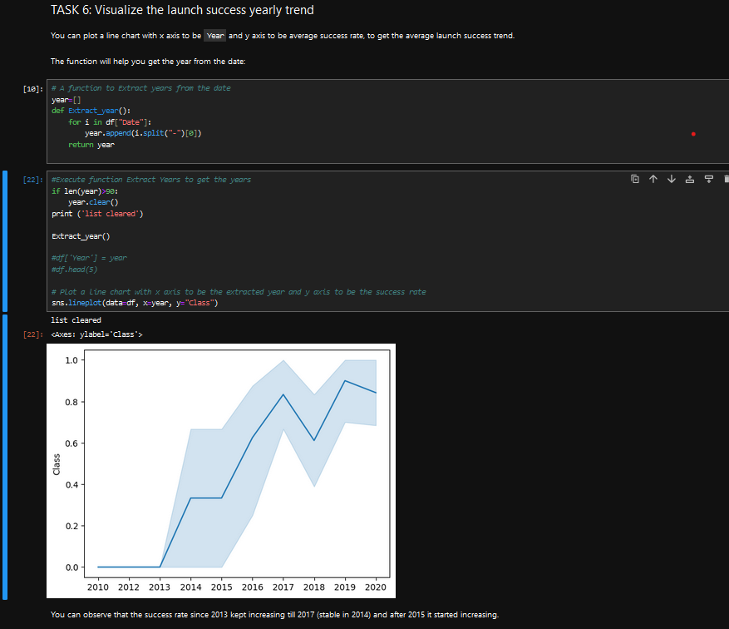
RESULTS (EDA with Visualization)

Slide 14
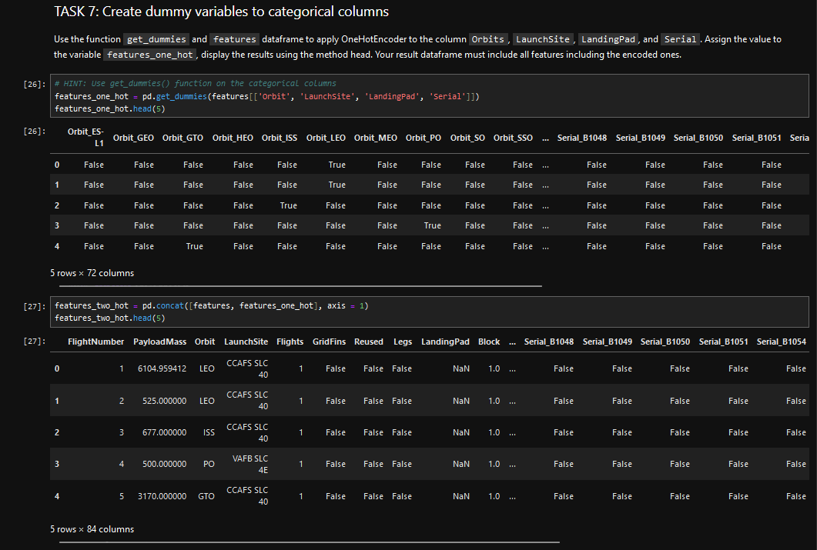
RESULTS (EDA with Visualization)

Slide 15
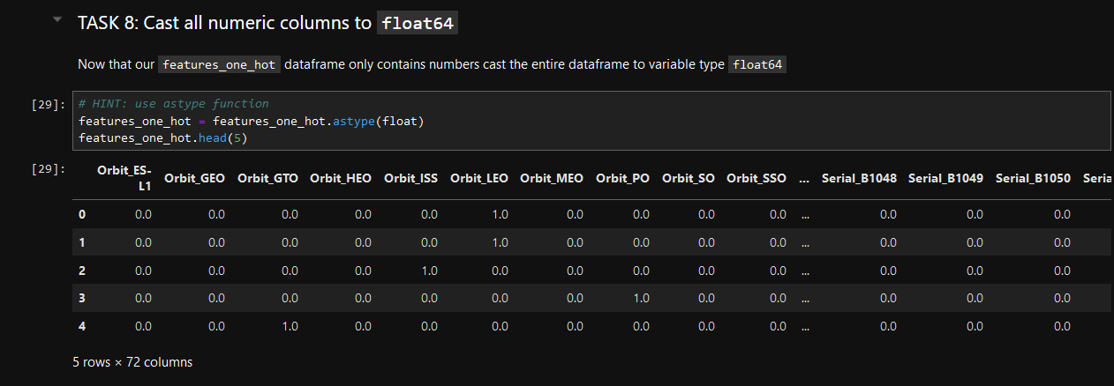
RESULTS (EDA with Visualization)

Slide 16
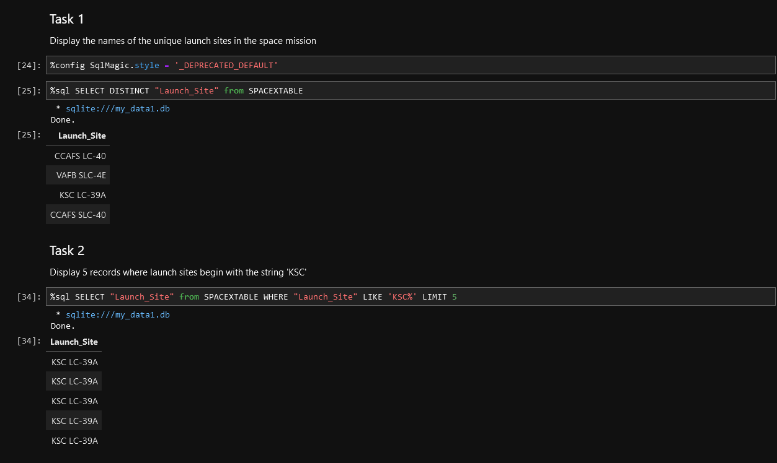
RESULTS (EDA with SQL)

Slide 17
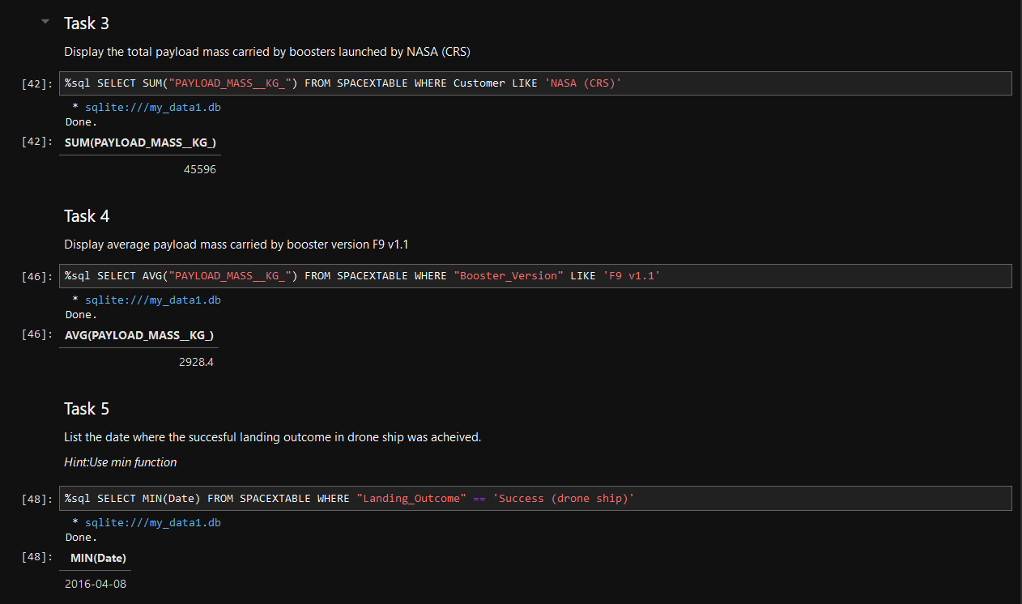
RESULTS (EDA with SQL)

Slide 18
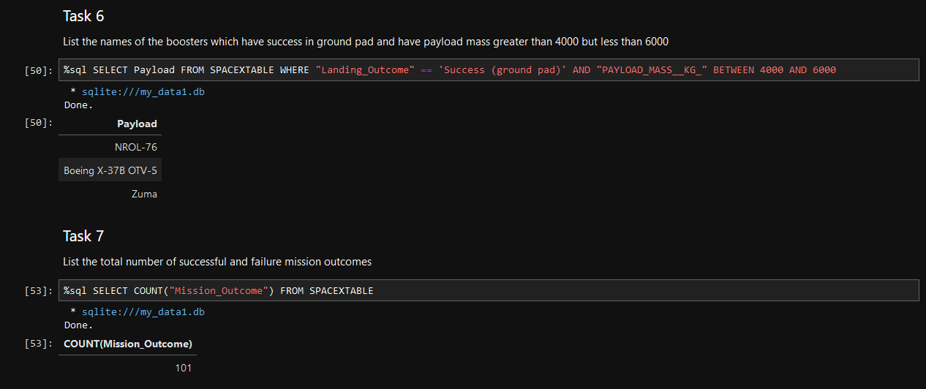
RESULTS (EDA with SQL)

Slide 19
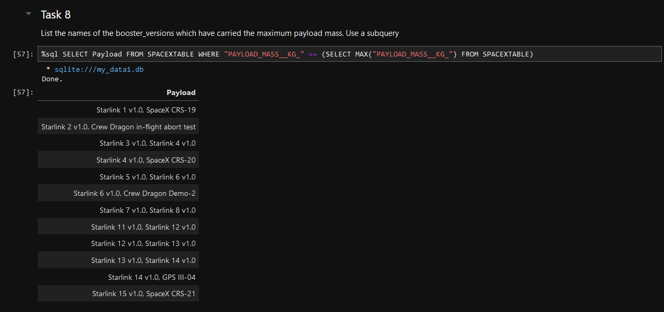
RESULTS (EDA with SQL)

Slide 20
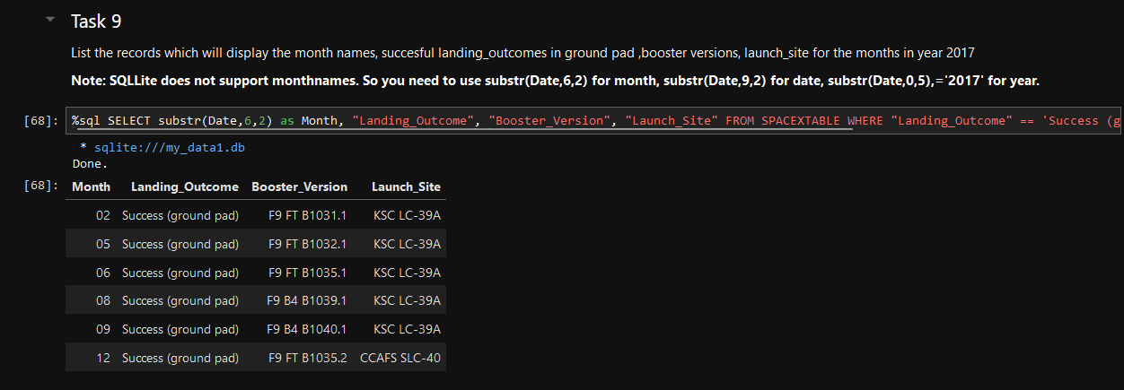
RESULTS (EDA with SQL)

Slide 21
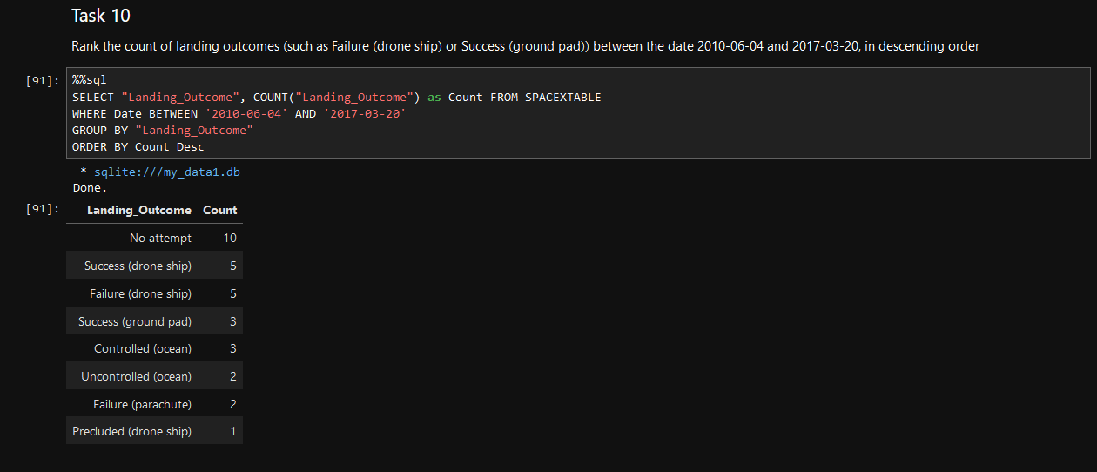
RESULTS (EDA with SQL)

Slide 22
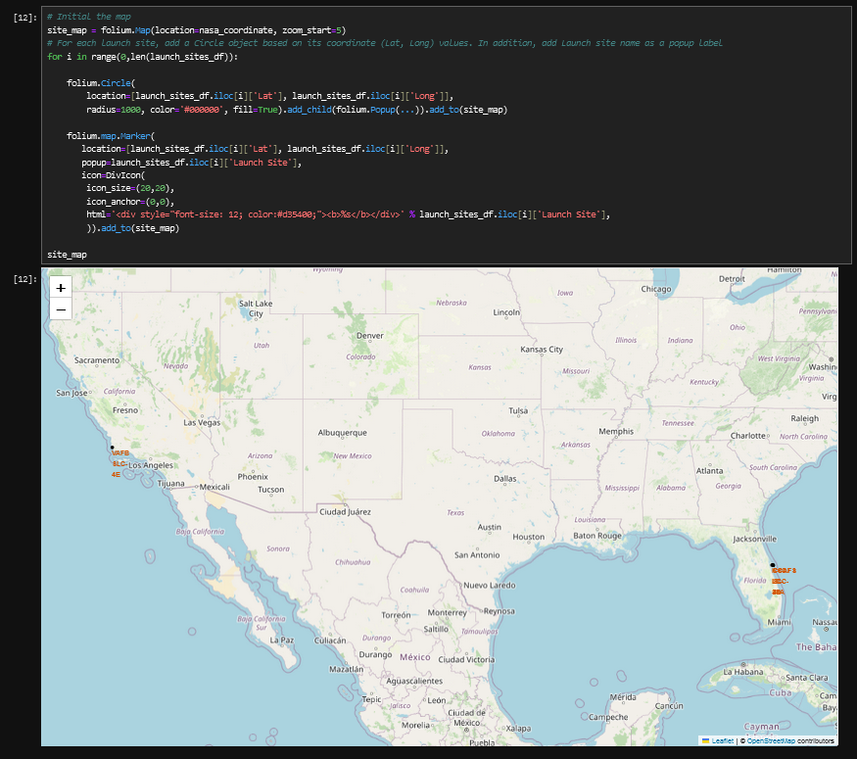
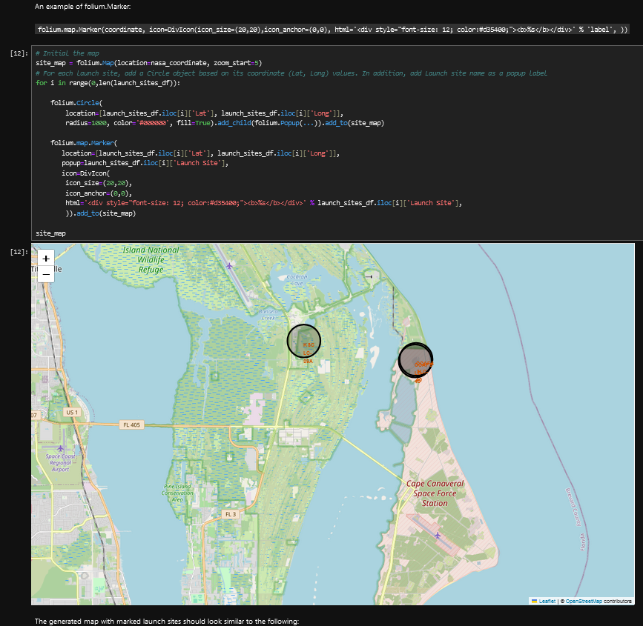
RESULTS (Interactive Map with Folium)

Slide 23
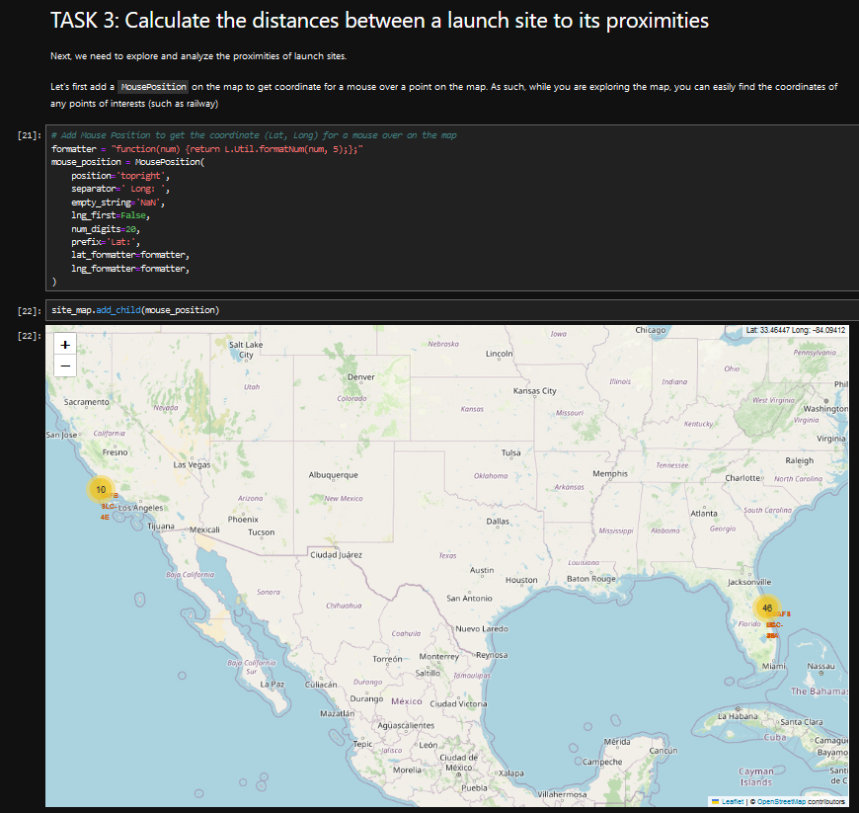
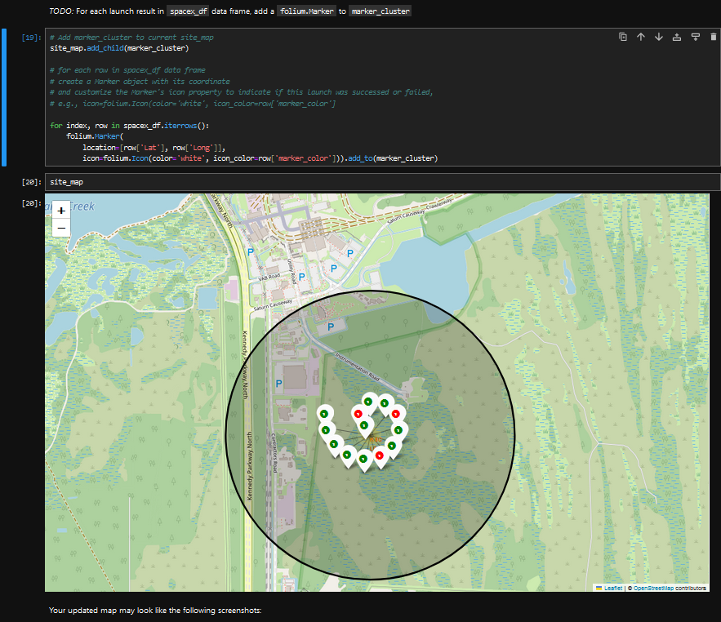
RESULTS (Interactive Map with Folium)

Slide 24
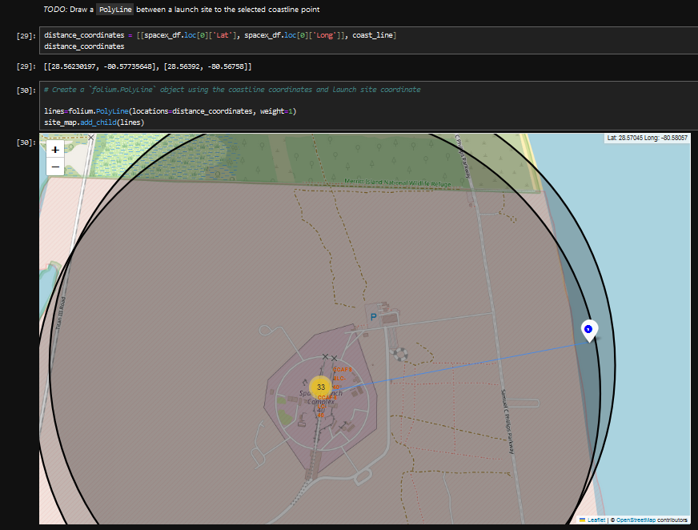
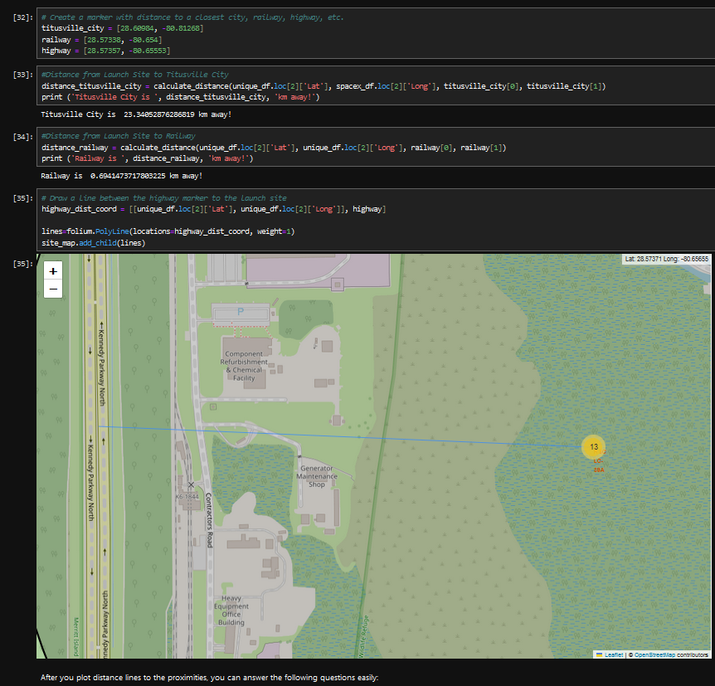
RESULTS (Interactive Map with Folium)

Slide 25
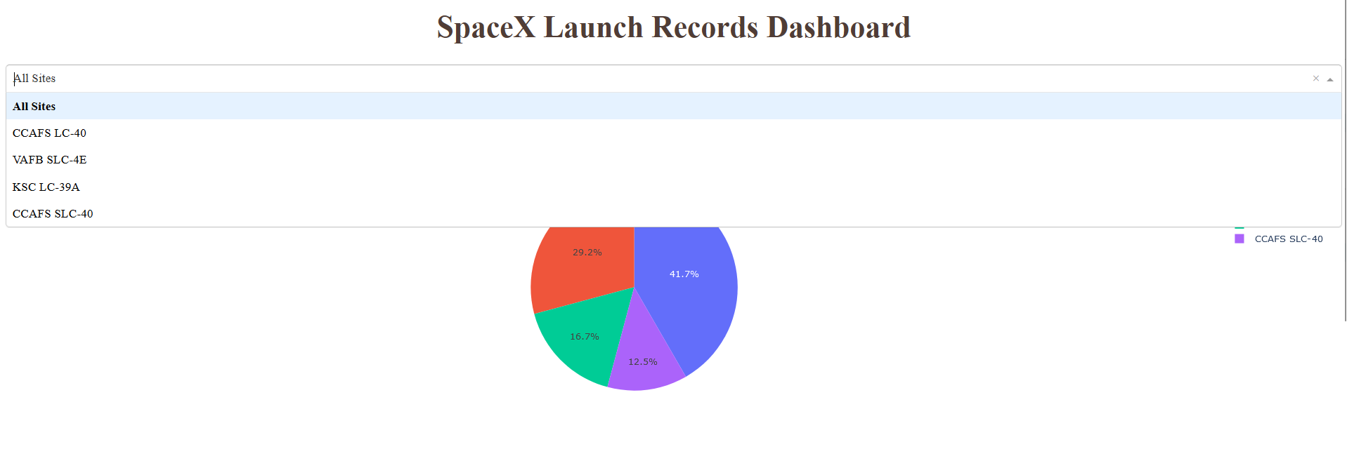
RESULTS (Plotly Dash Dashboard)

Slide 26
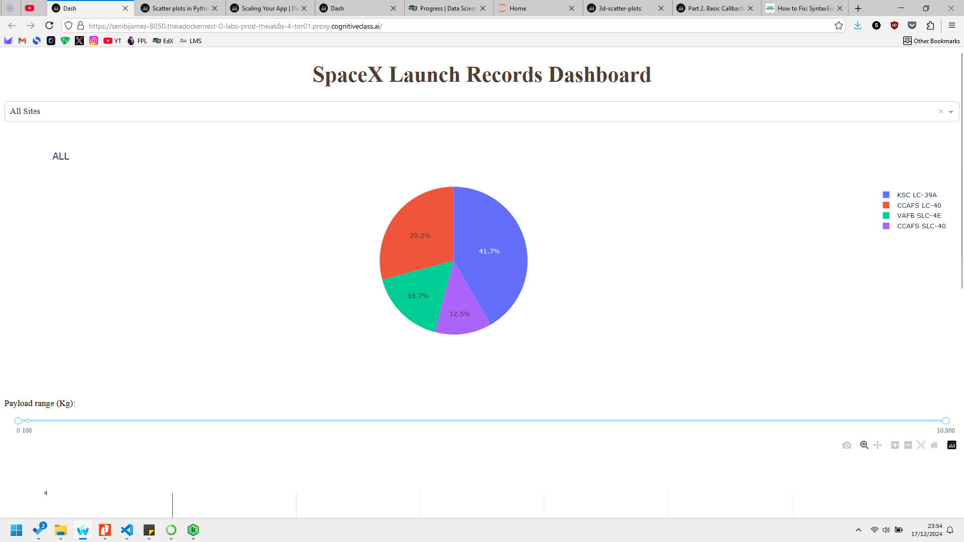
RESULTS (Plotly Dash Dashboard)

Slide 27
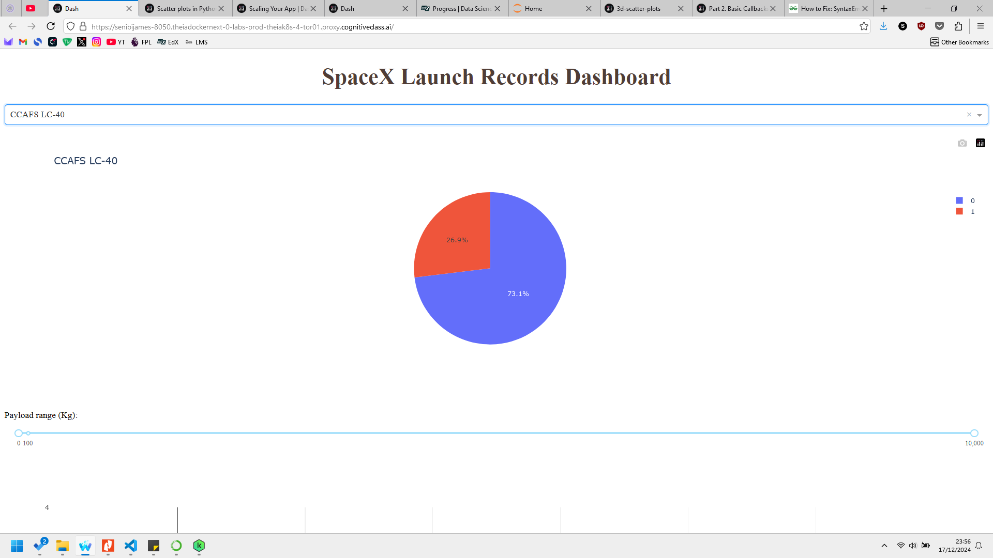
RESULTS (Plotly Dash Dashboard)

Slide 28
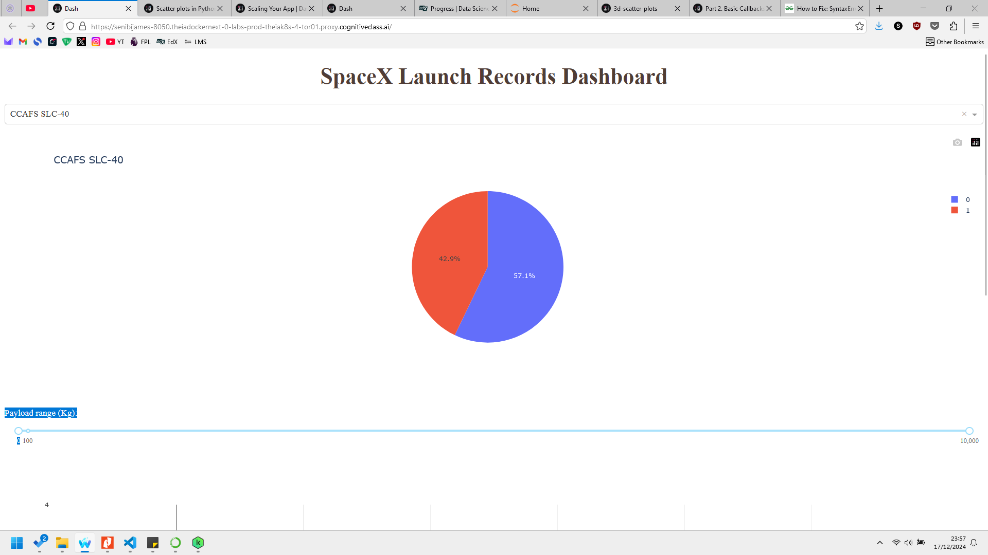
RESULTS (Plotly Dash Dashboard)

Slide 29
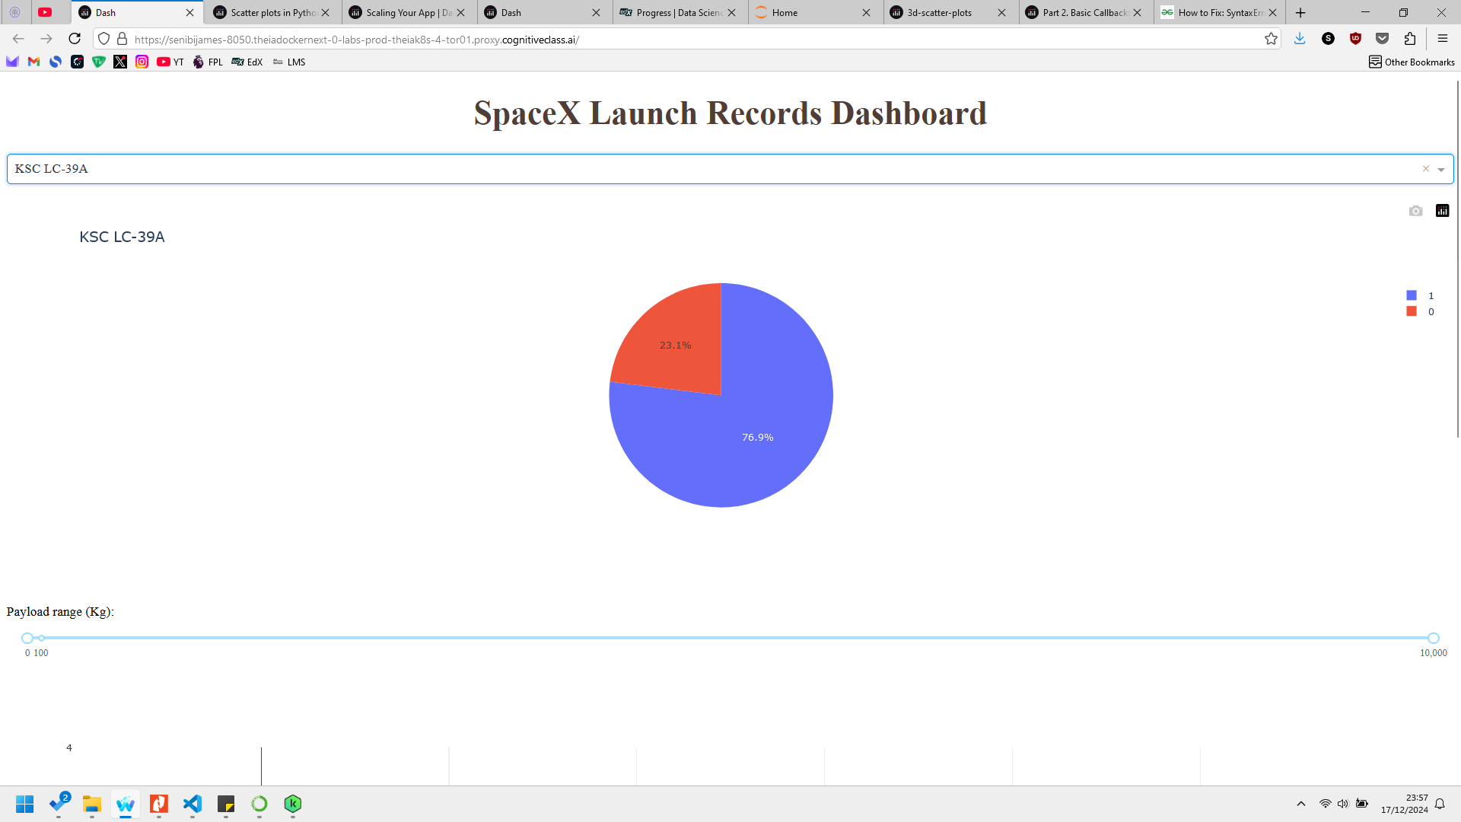
RESULTS (Plotly Dash Dashboard)

Slide 30
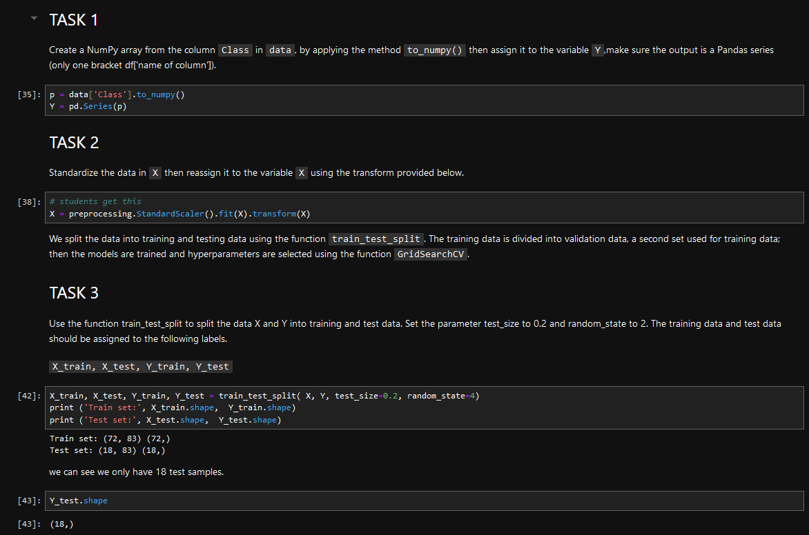
RESULTS (Predictive Analysis - Classification )

Slide 31
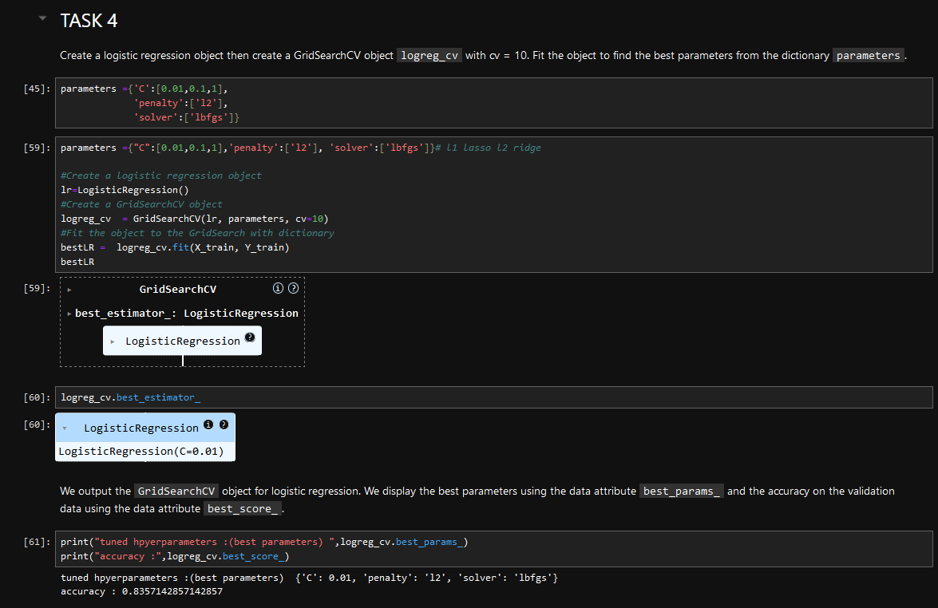
RESULTS (Predictive Analysis - Logistics Regression)

Slide 32
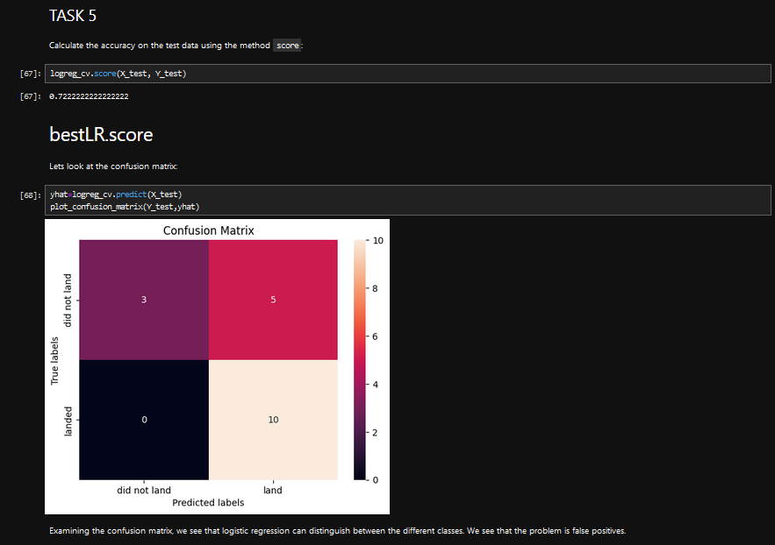
RESULTS (Predictive Analysis – Logistics Regression)

Slide 33
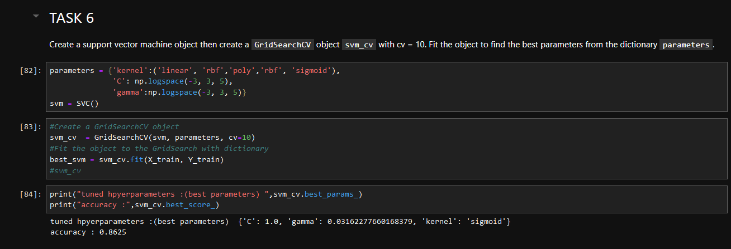
RESULTS (Predictive Analysis - Support Vector Machine)

Slide 34
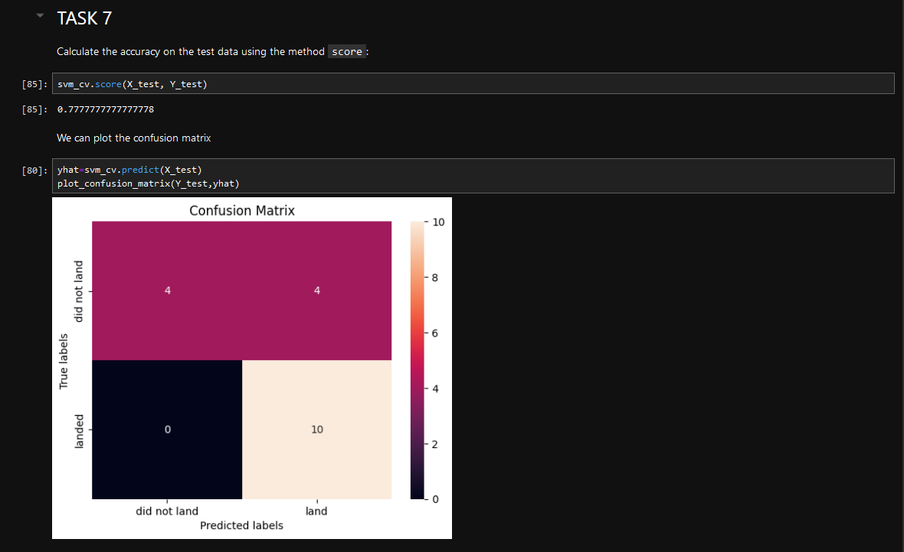
RESULTS (Predictive Analysis – Support Vector Machine)

Slide 35
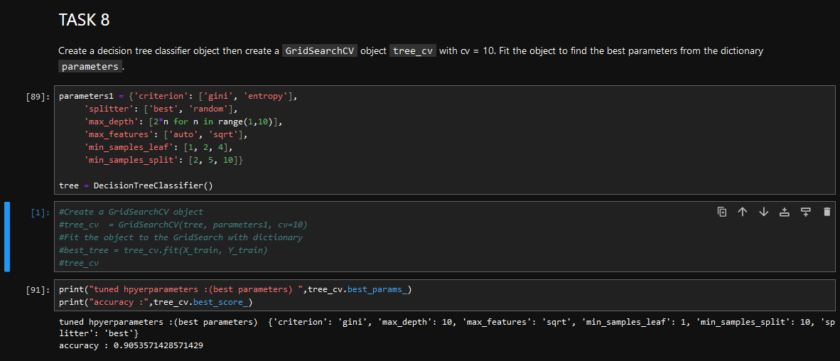
RESULTS (Predictive Analysis – Decision Tree)

Slide 36
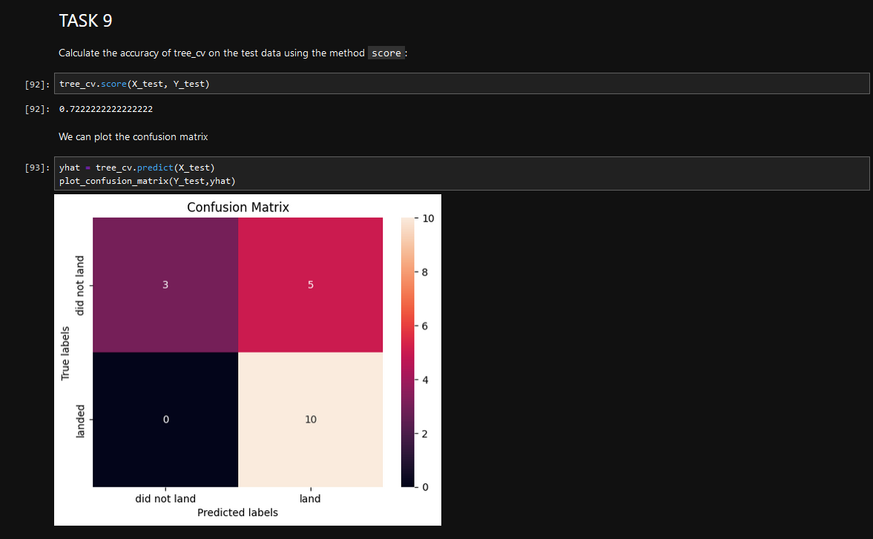
RESULTS (Predictive Analysis – Decision Tree)

Slide 37
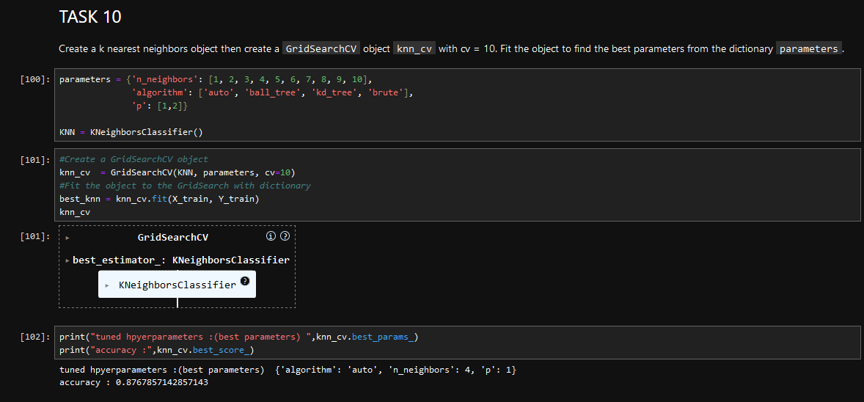
RESULTS (Predictive Analysis - K-Nearest Neighbor)

Slide 38
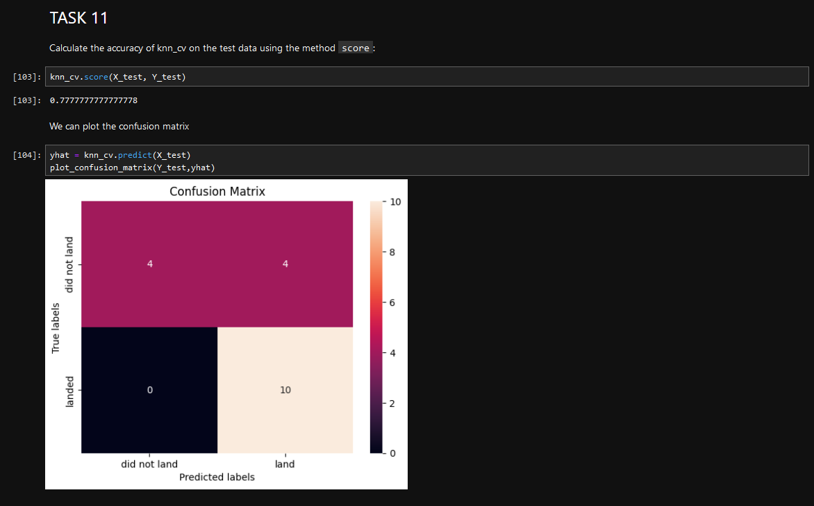
RESULTS (Predictive Analysis – K-Nearest Neighbor)

Slide 39
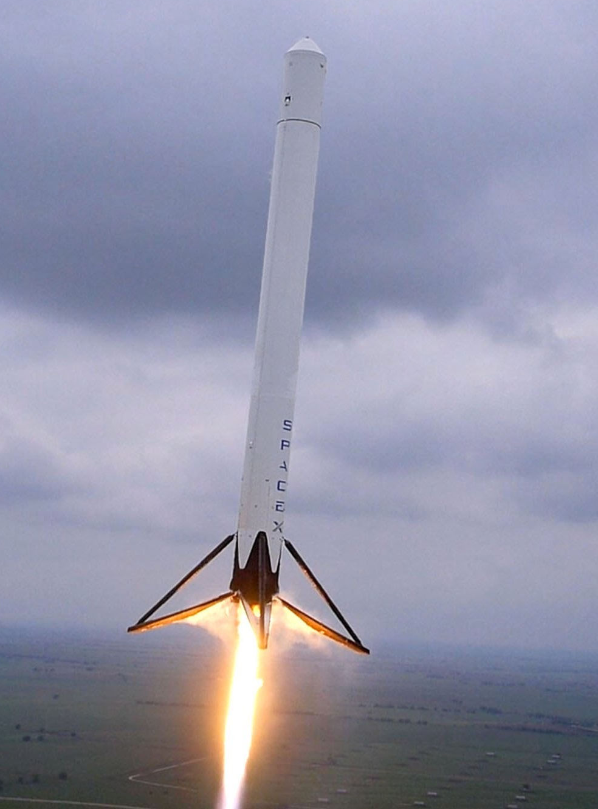
CONCLUSION
There is a higher chance of success with increased number of flights per launch site.
There is a 100% chance of success at launch site CCAFS SLC-40 for Payload mass over 10,000kg.
KSC LC-39A was the most used Space-X launch site while CCAFS SLC-40 was the least used.

Slide 40
CONCLUSION
ES-L1, GEO, HEO and SSO are ideal orbit candidates with 100% success rate.
For Flights number over 80, all orbits records 100% success rates. This might be due to re-adjusted parameters over time.
Successful launches generally improve over time.

Slide 41
CONCLUSION
There is close proximity between launch sites and coastal areas, highways and railways, but little or no proximity to cities.
Decision Trees Prediction Model is the most accurate model for this scenario with an accuracy of over 80%
Generally there is an estimated 80% chances of successfully recovering the first stage across all launch sites.

